Slide 1

Big, Practical Recommendations with Alternating Least Squares

Slide 2


Where’s Big Learning?
Next: Application Layer
Analytics
Machine Learning
Like Apache Mahout
Common Big Data app today
Clustering, recommenders, classifiers on Hadoop
Free, open source; not mature
Where’s commercialized Big Learning?
Applications
Processing
Database
Storage

Slide 3
A RECOMMENDER SHOULD …
Answer in Real-time
Ingest new data, now
Modify recommendations based on newest data
No “cold start” for new data
Scale Horizontally
For queries per second
For size of data set
Accept Diverse Input
Not just people and products
Not just explicit ratings
Clicks, views, buys
Side information
Be “Pretty Accurate”

Slide 4
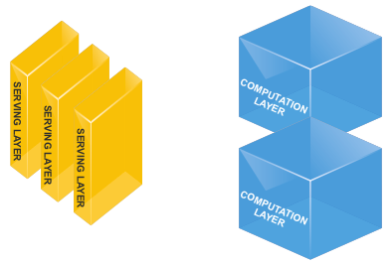
NEED: 2-TIER ARCHITECTURE
Real-time Serving Layer
Quick results based on precomputed model
Incremental update
Partitionable for scale
Batch Computation Layer
Builds model
Scales out (on Hadoop?)
Asynchronous, occasional, long-lived runs

Slide 5
A practical algorithm
Matrix factorization
Benefits
Factor user-item matrix to user-feature + feature-item matrix
Well understood in ML, as:
Principal Component Analysis
Latent Semantic Indexing
Several algorithms, like:
Singular Value Decomposition
Alternating Least Squares
Models intuition
Factorization is batch parallelizable
Reconstruction (recs) in low-dimension is fast
Allows projection of new data
Cold start solution
Approximate update solution

Slide 6
A practical IMPLEMENTATION
Alternating Least SQuares
Benefits
Simple factorization R ≈ Q P^{T}
Approximate: Q, P are “skinny” (low-rank)
Faster than the SVD
Trivially parallel, iterative
Dumber than the SVD
No singular values, orthonormal basis
Parallelizable by row -- very Hadoop-friendly
Iterative: OK answer fast, refine as long as desired
Yields to “binary” input model
Ratings as regularization instead
Sparseness / 0s no longer a problem

Slide 7
ALS Algorithm 1
Input: (user, item, strength) tuples
Anything you can quantify is input
Strength is positive
Many tuples per user-item
R is sparse user-item interaction matrix
r_{ij} = total strength of interaction between user i and item j
1 | 4 | 3
 |  | 3
 | 4 |  | 3 | 2
5 |  | 2 |  | 3
 |  |  | 5
2 | 4
R

Slide 8
ALS Algorithm 2
Follow “Collaborative Filtering for Implicit Feedback Datasets” www2.research.att.com/~yifanhu/PUB/cf.pdf
Construct “binary” matrix P
1 where R > 0
0 where R = 0
Factor P, not R
R returns in regularization
Still sparse; implicit 0s fine
1 | 1 | 1 | 0 | 0
0 | 0 | 1 | 0 | 0
0 | 1 | 0 | 1 | 1
1 | 0 | 1 | 0 | 1
0 | 0 | 0 | 1 | 0
1 | 1 | 0 | 0 | 0
P

Slide 9
ALS Algorithm
Optimizing Q, P simultaneously is non-convex, hard
If Q or P are fixed, system of linear equations: convex, easy
Initialize Q, P with random values
Fix Q, Solve for P
Fix P, solve for Q
Repeat (“Alternating”)
P^{T}
Q

Slide 10
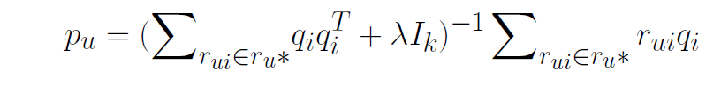

Algorithm: ALS for Matrix Completion
Initialize P,Q
repeat
for u = 1...n do
for i = 1..m do
Until convergence

Slide 11


Distributed ALS on Spark
Join ratings with Q factors using item id
Map to compute q_{i}q_{i}^{T} and change key to user id
Reduce by to compute using user id
Invert
Reduce by key user to compute

Slide 12
Challenges
Nodes crash due to large data size
Multiple node timeout due to large data shuffling.

Slide 13
Optimization
Part A matrix inversion using svd.
Broadcast ratings data to all nodes.
Use hashing to partition user and item matrix
data to nodes by user_id and item_id.

Slide 14
ALS Algorithm: Implicit Feedback
Define regularization weights c_{ui} = 1 + α r_{ui}
Minimize: Σ c_{ui}(p_{ui} – x_{u}^{T}y_{i})² + λ(Σ||x_{u}||² + Σ||y_{i}||²)
Simple least-squares regression objective, plus
Weighted least-squared error terms by strength, a penalty for not reconstructing 1 at “strong” association is higher
Standard L2 regularization term

Slide 15
ALS Algorithm: Implicit Feedback
With fixed Y, compute optimal X
Each row x_{u} is independent
Define C_{u} as diagonal matrix of c_{u} (user strength weights)
x_{u} = (Y^{T}C_{u}Y + λI)⁻¹ Y^{T}C_{u}p_{u}
Compare to simple least-squares regression solution (Y^{T}Y)⁻¹ Y^{T}p_{u}
Adds Tikhonov / ridge regression regularization term λI
Attaches c_{u} weights to Y^{T}
See paper for how Y^{T}C_{u}Y is computed efficiently; skipping the engineering!

Slide 16
Example factorization
k = 3, λ = 2, α = 40, 10 iterations
1 | 1 | 1 | 0 | 0
0 | 0 | 1 | 0 | 0
0 | 1 | 0 | 1 | 1
1 | 0 | 1 | 0 | 1
0 | 0 | 0 | 1 | 0
1 | 1 | 0 | 0 | 0
0.96 | 0.99 | 0.99 | 0.38 | 0.93
0.44 | 0.39 | 0.98 | -0.11 | 0.39
0.70 | 0.99 | 0.42 | 0.98 | 0.98
1.00 | 1.04 | 0.99 | 0.44 | 0.98
0.11 | 0.51 | -0.13 | 1.00 | 0.57
0.97 | 1.00 | 0.68 | 0.47 | 0.91
≈
R = Q•P^{T}

